Slide 1

The Global Data Barometer
Mapping the GDB’s utility for Sub-Saharan Africa
Presented by:
Linet Juma
Program Officer, LDRI

Slide 2
Presentation Outline
01
02
03
  The GDB in Sub-Saharan Africa
Mapping the GDB’s utility for Sub-Saharan Africa
  About LDRI

Slide 3
About LDRI

Slide 4
The GDB in Sub-Saharan Africa
Areas Covered:
Governance, Capability, Climate Action, Public Finance, Health and Covid-19,Political Integrity, Public Procurement and Company Information
Countries covered:
Angola, Benin, Botswana, Burkina Faso, Cabo Verde, Côte d'Ivoire, DR Congo, Ethiopia, Ghana, Kenya, Liberia, Malawi, Morocco, Mozambique, Namibia, Nigeria, Rwanda, Senegal, Seychelles, Sierra Leone, South Africa, Togo, Tunisia and Uganda

Slide 5
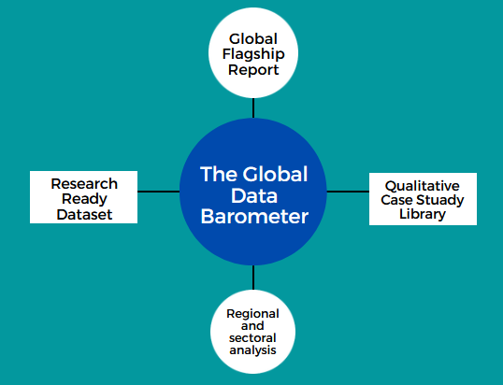
The GDB Outputs
Global Report
Regional and sectoral analysis and country profiles
Research Ready Dataset
Qualitative Case Study Library

Slide 6
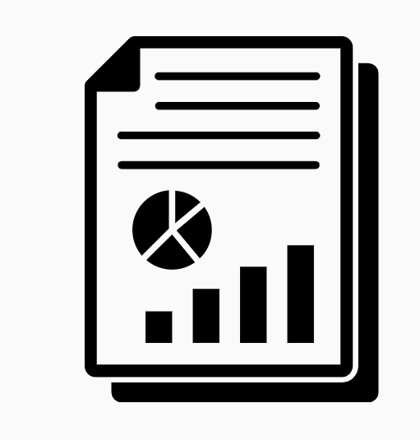
Global Flagship Report
Providing a critical new benchmark on country-level data governance, data capability, data availability, and data use for the public good
Driving data for development through the provision of evidence that advances the governance and use of data as a tool to deliver the 2030 Agenda for Sustainable Development.

Slide 7

Regional and sectoral analysis
Provide actionable insights on how data is working in specific sectors
Opportunities for cross-learning across sectors
Potential entry points for stakeholders implementing country and sector specific initiatives

Slide 8

Powering Critical research
Providing a research ready dataset
The dataset will drive improvements in research on data governance, capability, availability, and use, and will support the creation of research papers and reports.
Sharing our methods and data under an open license.

Slide 9

Qualitative Case Study Library
Surfacing context relevant case studies on existing data governance frameworks, available datasets and use cases across multiple countries and sectors

Slide 10


THANK YOU
Local Development Research Institute (LDRI)
Twitter: @ldriafrica | Facebook: @ldriafrica
www.developlocal.org

